Slide 1
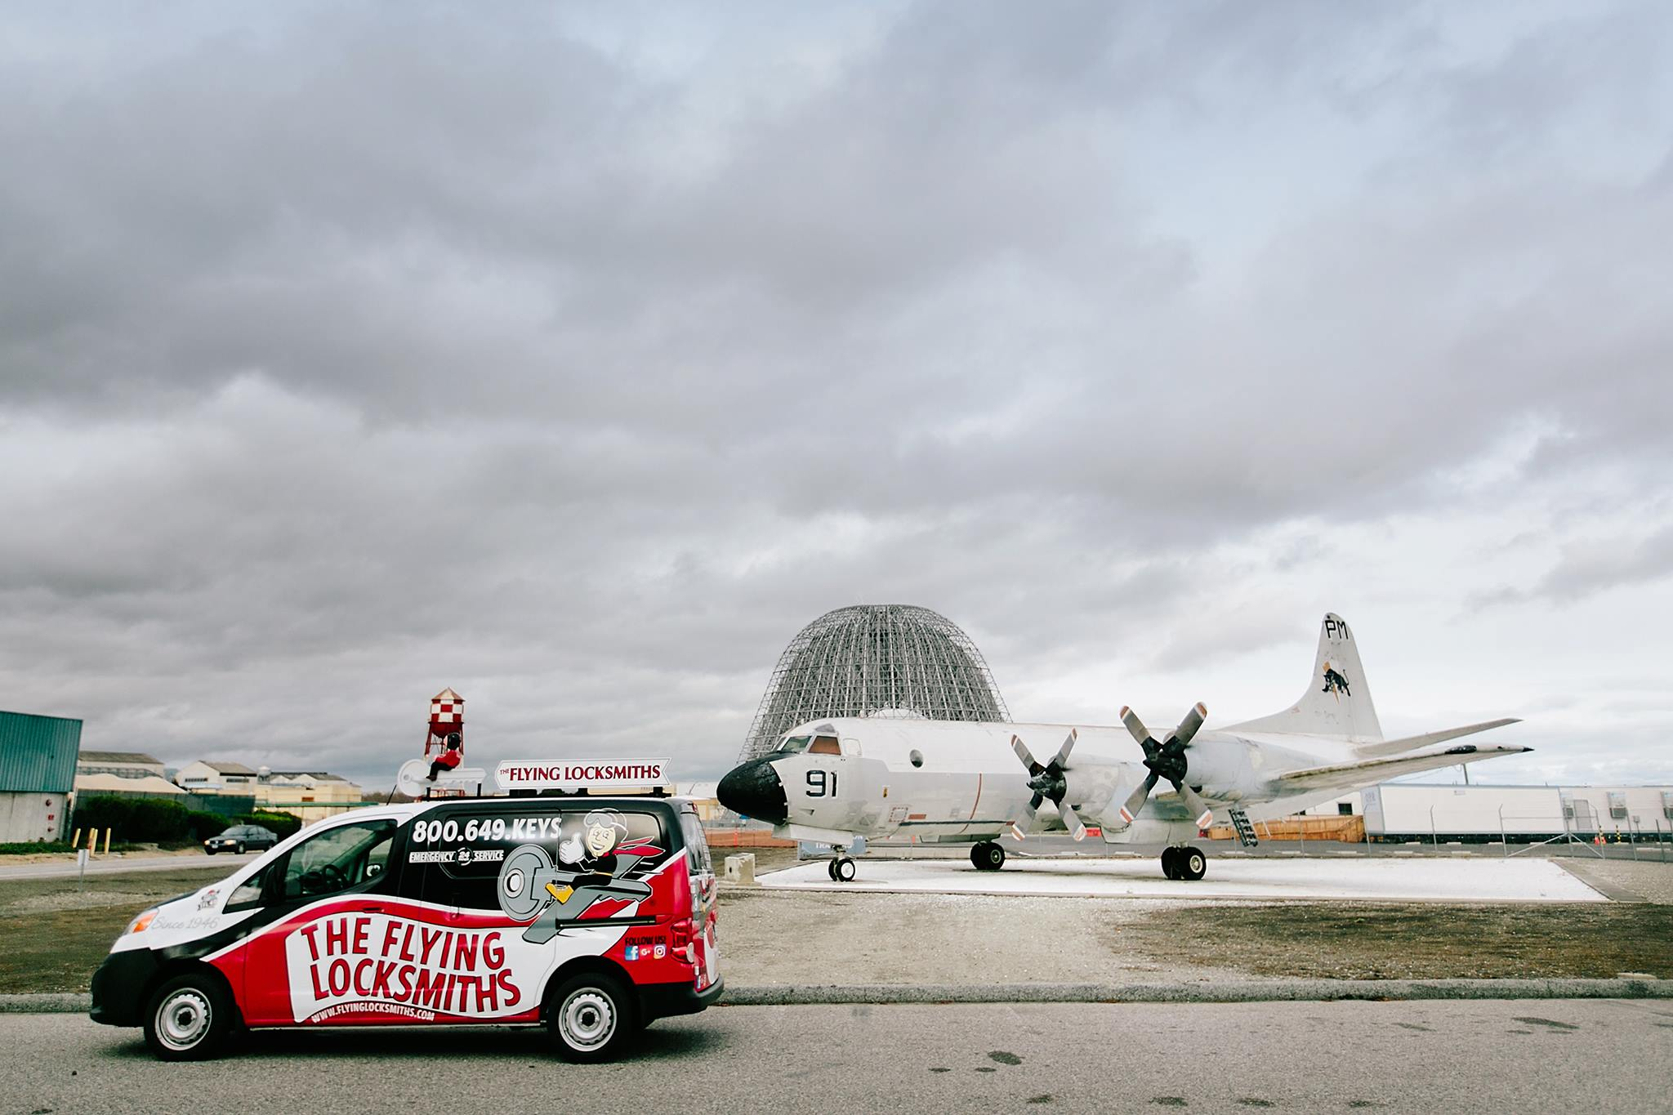
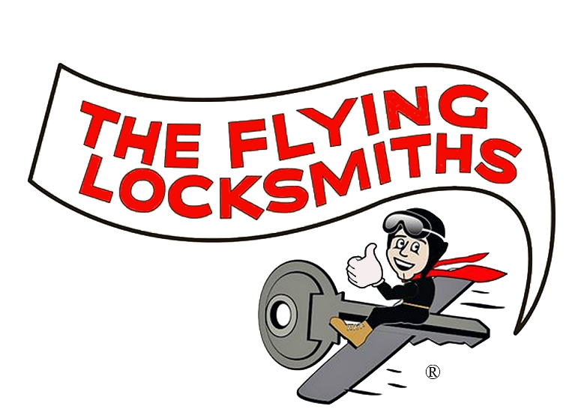
Franchise Introduction
PROVIDING QUALIFIED, TRUSTWORTHY NATIONWIDE
COMMERCIAL & RESIDENTIAL SECURITY SOLUTIONS
Geoff Batchelder
+1 (877) 222-3722
geoffb@flyinglocksmiths.com
Dennis Mulgannon
+1 (408) 318-5606
dennism@flyinglocksmiths.com
100 Grossman Drive Suite 305 Braintree, MA 02184

Slide 2

DISCLAIMER
This advertisement is not an offering. An offering can only be made by a prospectus filed first with the Department of Law of the State of New York. Such filing does not constitute approval by the Department of Law.
Minnesota Franchise Registration #F-7577

Slide 3
PROVIDING QUALIFIED, TRUSTWORTHY NATIONWIDE
COMMERCIAL & RESIDENTIAL SECURITY SOLUTIONS
If you are tired of looking at sandwich shops, cleaning services and senior care, this could be the one for you!
The Flying Locksmiths (TFL) is a white collar business management franchise opportunity in an industry that has been fragmented for decades with “Mom & Pop” operators.
We are seeking franchise partners looking to scale a business and manage a business, versus working in the field.
The mission of the company is simple: provide top of the line security products and services, utilizing the latest technologies, while staying true to family values.
TFL Franchise Systems, LLC ® 2020
100 Grossman Drive Suite 305 Braintree, MA 02184

Slide 4
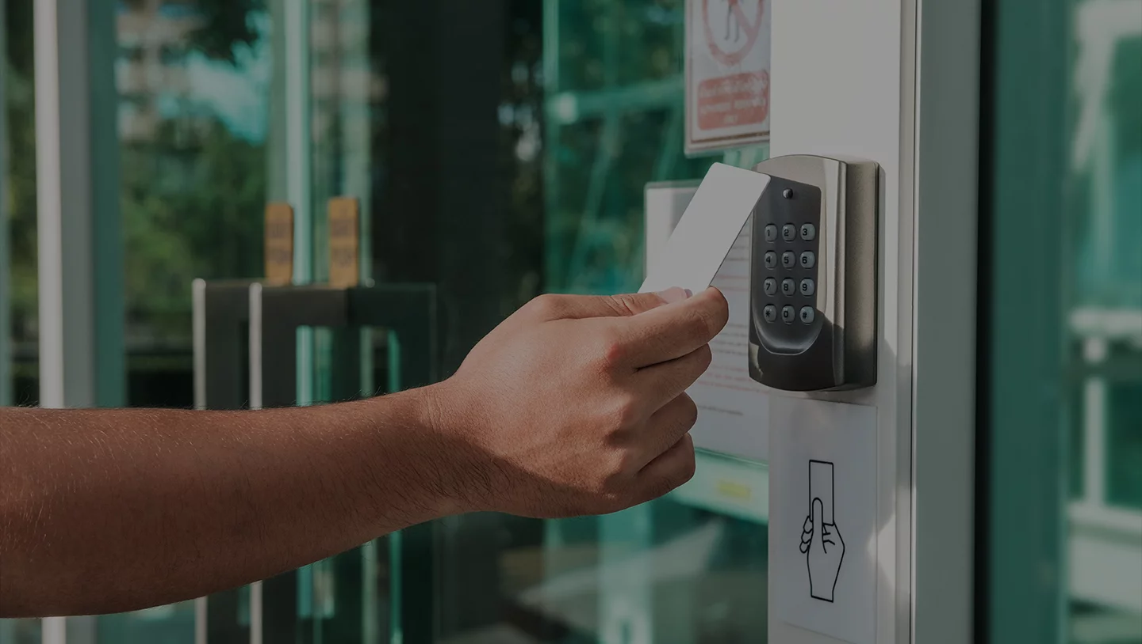
PROVIDING QUALIFIED, TRUSTWORTHY NATIONWIDE
COMMERCIAL & RESIDENTIAL SECURITY SOLUTIONS
PHYSICAL SECURITY SPECIALISTS.
  The locksmith industry has drastically changed and TFL is the catalyst for that change. By offering more than just standard locksmith services, putting an emphasis on unparalleled customer service and identifying, vetting, and installing the latest high tech products – TFL has created an unrivaled national service delivery platform.
  We define ourselves as Physical Security Specialists because while we are extremely competent when it comes to rekeying your locks or installing door hardware, our teams will also implement full card access systems, with security cameras and complete a thorough security assessment of your home or buildings security, by adjusting door closures, exit devices and ensuring handicap operators are in compliance.
IF IT’S ON THE DOOR, WE HANDLE IT.
TFL Franchise Systems, LLC ® 2020
100 Grossman Drive Suite 305 Braintree, MA 02184

Slide 5
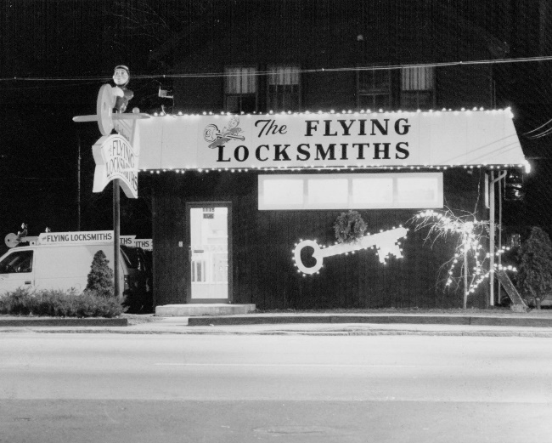
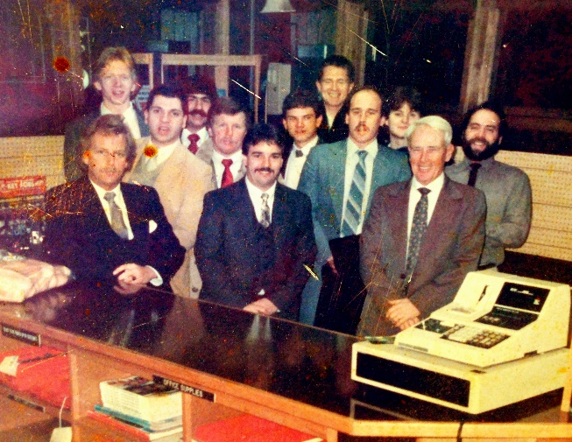
PROVIDING QUALIFIED, TRUSTWORTHY NATIONWIDE
COMMERCIAL & RESIDENTIAL SECURITY SOLUTIONS
We have been in business in the challenging Boston market for over 70 years!
Years of locksmith experience and business education are two of the main components that create the framework of The Flying Locksmiths leadership team.
What started as a small business operated out of a Jeep with one key machine in 1946 has turned into the most respected Locksmith Services company in Boston, with annual revenues over $1,700,000.
There are now 3 generations of the family involved in every aspect of the operation. The combination of generations has created a blend of old school ideals and new age tech, resulting in a mix that offers the newest products with a friendly neighborly smile.
TFL Franchise Systems, LLC ® 2020
100 Grossman Drive Suite 305 Braintree, MA 02184

Slide 6
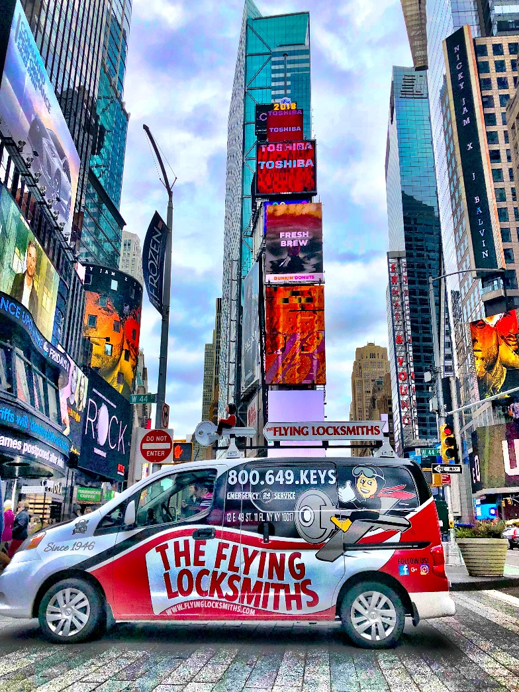
PROVIDING QUALIFIED, TRUSTWORTHY NATIONWIDE
COMMERCIAL & RESIDENTIAL SECURITY SOLUTIONS
We have accounts with some of the best known companies in the U.S. There are hundreds of accounts in our program, here is just a small sample:
  ADT, Forever21, American Eagle, BJs Brewhouse, Cubesmart, Costco, Hyatt Hotels, FedEx, Dunkin Donuts, Panda Express, Lowes, Simon Companies, Wal-Mart, TJ Maxx, McDonald’s, Red Robin, Bank of America, Gentle Dental, MetroPCS, Colliers International, KinderCare, Sunrise Senior Living and Bright Horizons.
  90% of the revenue comes from work in the commercial sector!
  The Locksmith / Access Control market is over $37 billion annually.
TFL Franchise Systems, LLC ® 2020
100 Grossman Drive Suite 305 Braintree, MA 02184

Slide 7
PROVIDING QUALIFIED, TRUSTWORTHY NATIONWIDE
COMMERCIAL & RESIDENTIAL SECURITY SOLUTIONS
Customer Testimonials
  “My company is highly regulated by the TSA and must be kept completely secure at all times. We utilize the expertise of The Flying Locksmiths to establish our highly secured warehouse and distribution center. I would highly recommend them to anybody seeking a secure environment for their business or their home.”
  ~
  “The Flying Locksmiths installed the hardware for all the doors at my brother’s keeper when we built our new facility in 2002. We’re as satisfied with
  The Flying Locksmiths, as we were nine years ago. Thanks for a great job! “
  ~
  “Incredibly courteous, trustworthy, and quick. I had to go twice to have automotive keys copied and programmed — and what would normally be a hassle was actually a fun experience. And their fees are very reasonable for locksmiths in Boston. In the future I'll go nowhere else. “
TFL Franchise Systems, LLC ® 2020
100 Grossman Drive Suite 305 Braintree, MA 02184

Slide 8
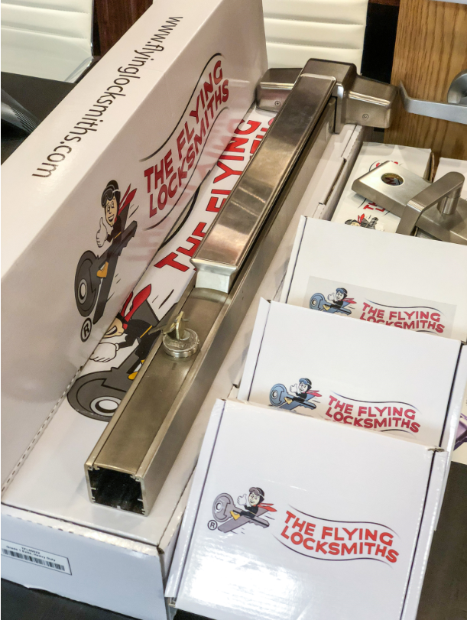
PROVIDING QUALIFIED, TRUSTWORTHY NATIONWIDE
COMMERCIAL & RESIDENTIAL SECURITY SOLUTIONS
Revenue From Multiple Products and Services
Deadbolts
Door Closers
Padlocks
File Cabinet Keys & Locks
Security Vault Installation
Chip Keys
Key by VIN
Doors
Door Repairs and Hinges
Door Alarms
Card Access & Keypads
Exit Devices / Crash Bars
Intercom Systems
CCTV/Security Cameras
High Security Keys & Locks
Electric Strikes
Master Key Systems
Lock Rekeying
House Keys
TFL Franchise Systems, LLC ® 2020
100 Grossman Drive Suite 305 Braintree, MA 02184

Slide 9
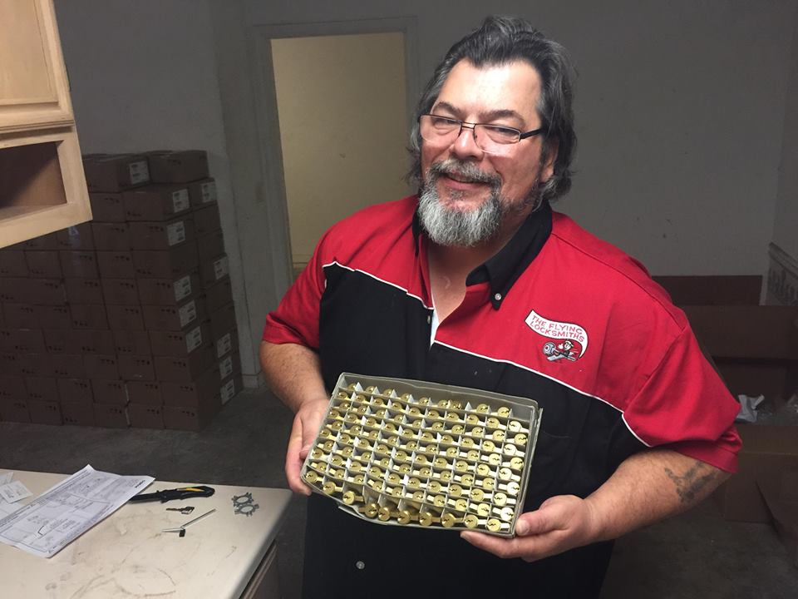
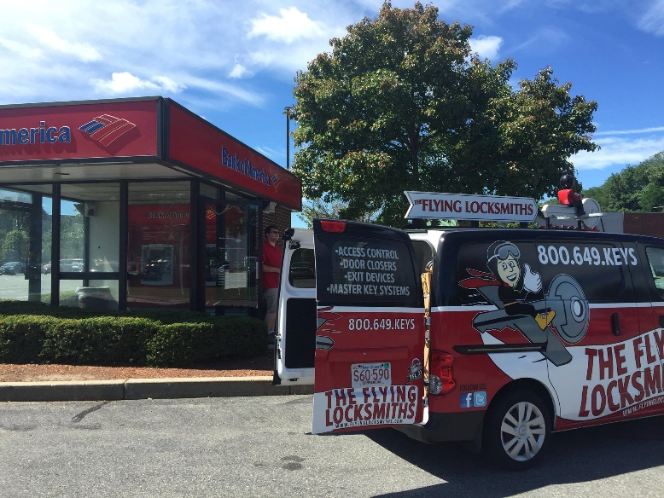
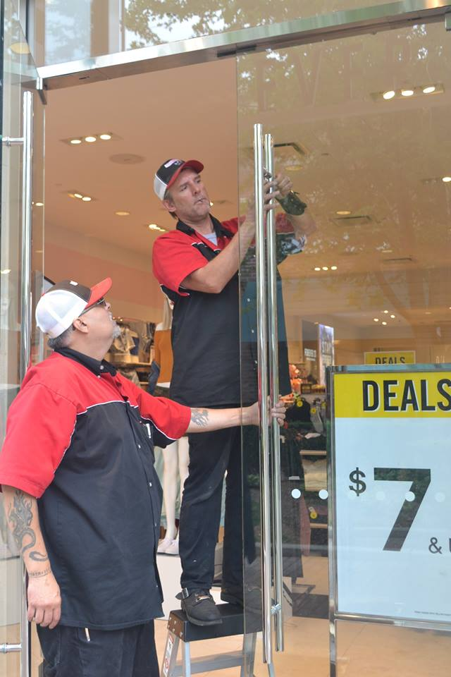
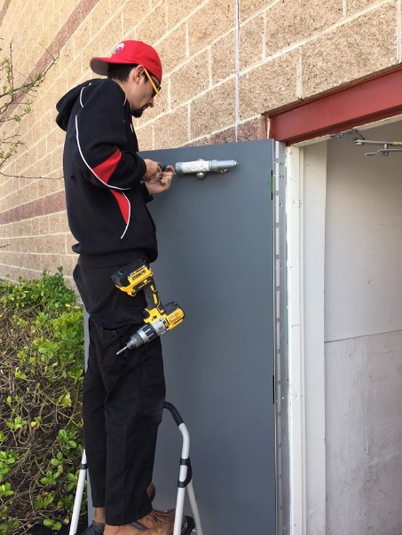
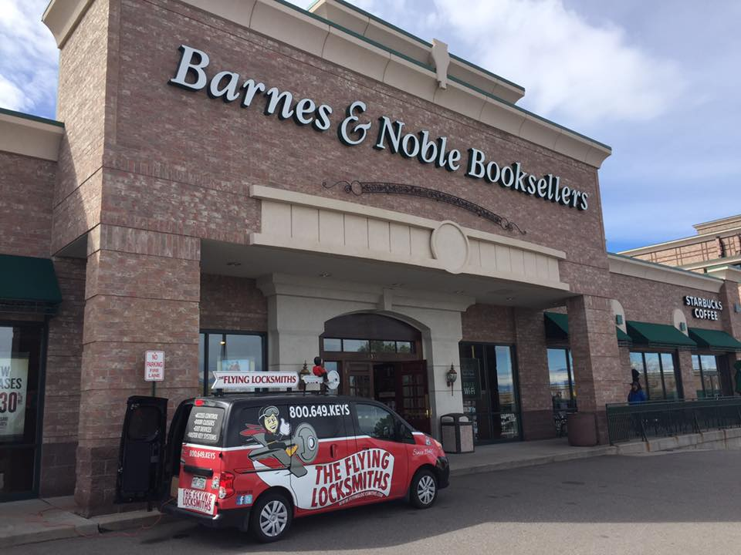
PROVIDING QUALIFIED, TRUSTWORTHY NATIONWIDE
COMMERCIAL & RESIDENTIAL SECURITY SOLUTIONS
TFL Franchise Systems, LLC ® 2020
100 Grossman Drive Suite 305 Braintree, MA 02184

Slide 10
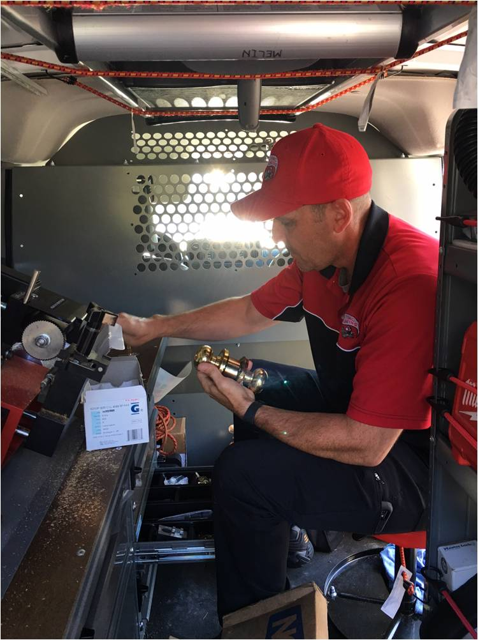
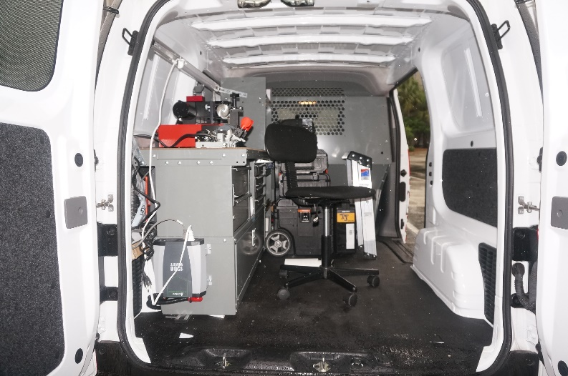
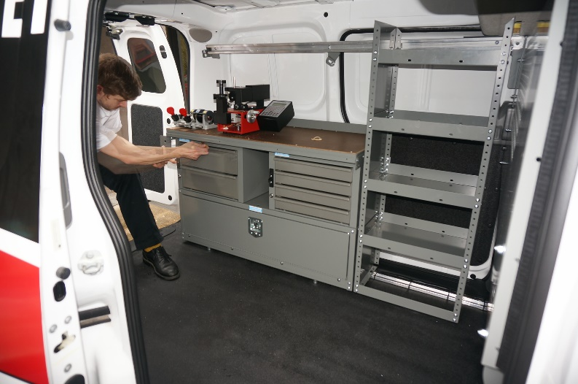
PROVIDING QUALIFIED, TRUSTWORTHY NATIONWIDE
COMMERCIAL & RESIDENTIAL SECURITY SOLUTIONS
TFL Franchise Systems, LLC ® 2020
100 Grossman Drive Suite 305 Braintree, MA 02184

Slide 11
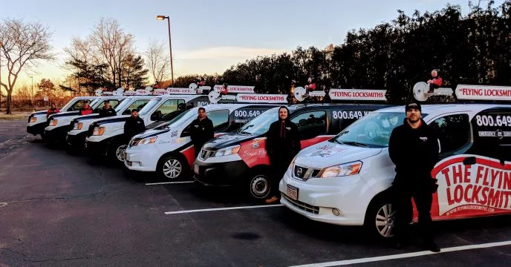
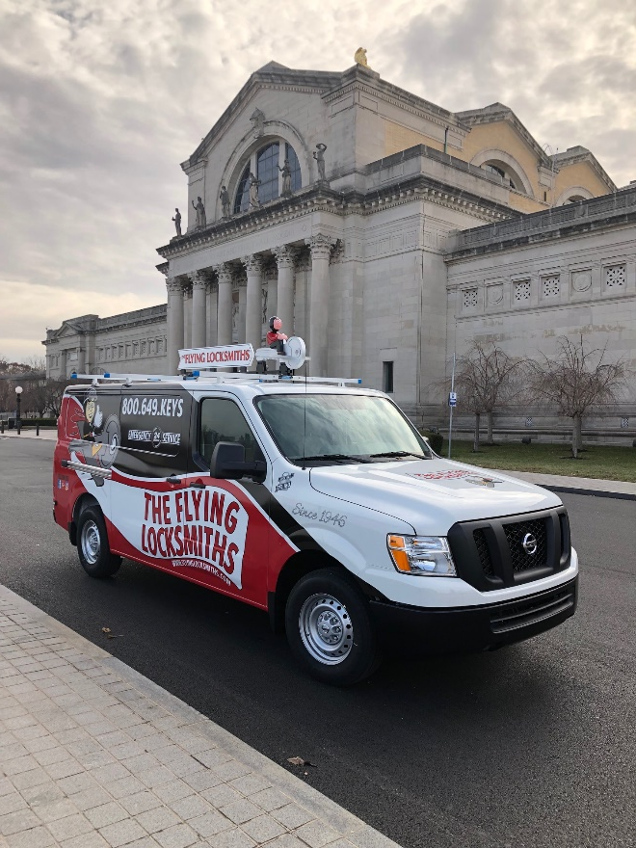
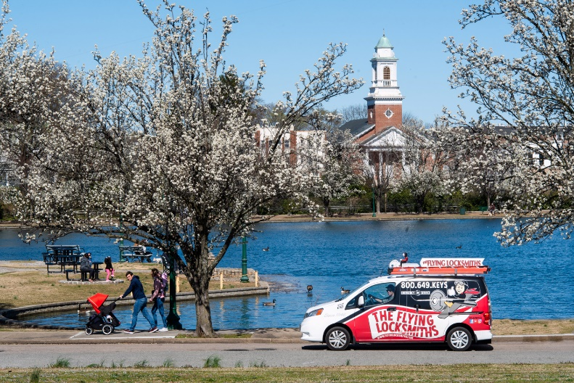
PROVIDING QUALIFIED, TRUSTWORTHY NATIONWIDE
COMMERCIAL & RESIDENTIAL SECURITY SOLUTIONS
TFL Franchise Systems, LLC ® 2020
100 Grossman Drive Suite 305 Braintree, MA 02184

Slide 12
PROVIDING QUALIFIED, TRUSTWORTHY NATIONWIDE
COMMERCIAL & RESIDENTIAL SECURITY SOLUTIONS
TFL Franchise Systems, LLC ® 2020
100 Grossman Drive Suite 305 Braintree, MA 02184

Slide 13
PROVIDING QUALIFIED, TRUSTWORTHY NATIONWIDE
COMMERCIAL & RESIDENTIAL SECURITY SOLUTIONS
TFL Franchise Systems, LLC ® 2020
100 Grossman Drive Suite 305 Braintree, MA 02184

Slide 14
PROVIDING QUALIFIED, TRUSTWORTHY NATIONWIDE
COMMERCIAL & RESIDENTIAL SECURITY SOLUTIONS
TFL Franchise Systems, LLC ® 2020
100 Grossman Drive Suite 305 Braintree, MA 02184

Slide 15
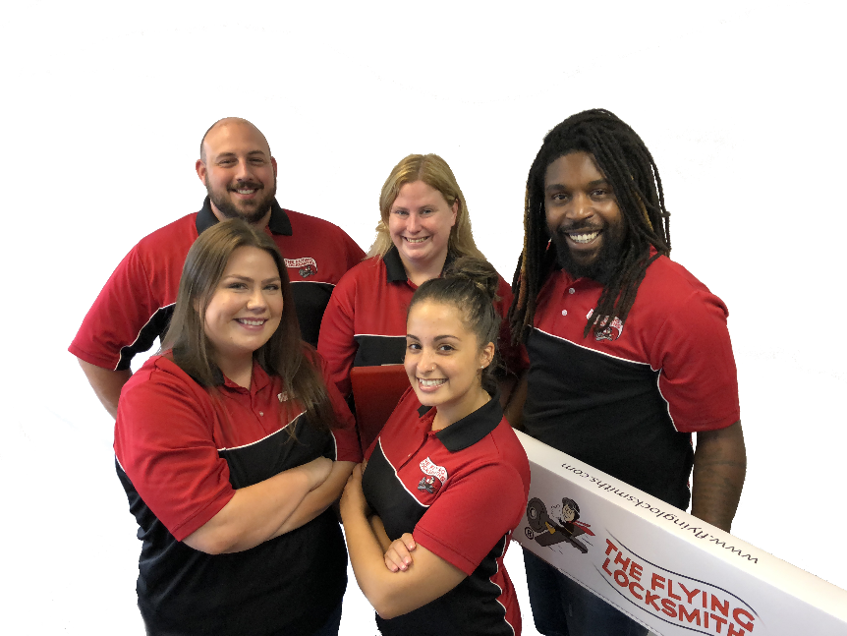
PROVIDING QUALIFIED, TRUSTWORTHY NATIONWIDE
COMMERCIAL & RESIDENTIAL SECURITY SOLUTIONS
Partial List of Customer Segments
Property Managers
Security Integrators
Commercial Service Companies
Multiple Site Retail
Contractors
Realtors
School Systems
Restaurants
Gas & Electric Providers
Day Care Centers
Assisted Living Centers
Healthcare Providers
TFL Franchise Systems, LLC ® 2020
100 Grossman Drive Suite 305 Braintree, MA 02184

Slide 16
PROVIDING QUALIFIED, TRUSTWORTHY NATIONWIDE
COMMERCIAL & RESIDENTIAL SECURITY SOLUTIONS
The top 25% of franchise locations that had a full year of operations in 2019 (our 3rd full year of franchisee data) had an average gross revenue of $719,530.02 ! Our top performer did $1,302,484.24 *
*See important disclosures and qualifications in Item 19 of our Franchise Disclosure Document. Your actual results may vary.
TFL Franchise Systems, LLC ® 2020
100 Grossman Drive Suite 305 Braintree, MA 02184

Slide 17
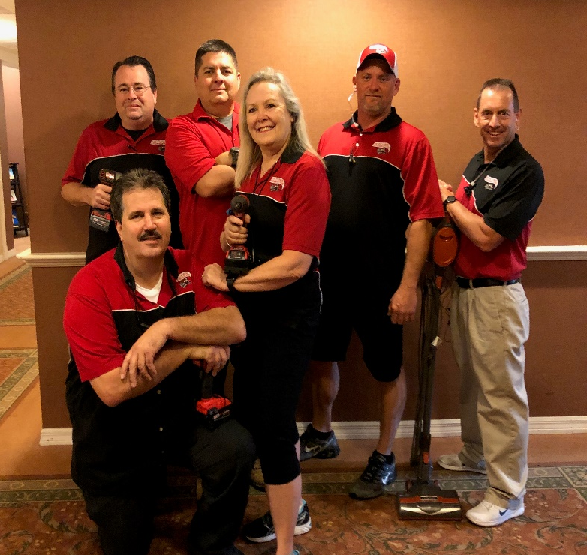
PROVIDING QUALIFIED, TRUSTWORTHY NATIONWIDE
COMMERCIAL & RESIDENTIAL SECURITY SOLUTIONS
Every business owner has to wear many hats, but here are some of the major responsibilities you’ll have as a TFL owner:
Sales & Marketing, Networking with business owners.
Support the field technicians.
Customer satisfaction.
Manage financial aspects of the business - accounts receivable and accounts payable.
Human resources – payroll and other tasks related to employees.
Assist with estimates, especially for larger jobs.
Manage inventory.
TFL Franchise Systems, LLC ® 2020
100 Grossman Drive Suite 305 Braintree, MA 02184

Slide 18
PROVIDING QUALIFIED, TRUSTWORTHY NATIONWIDE
COMMERCIAL & RESIDENTIAL SECURITY SOLUTIONS
Franchise Fees and Territories
The minimum franchise fee is $75,000 for a territory of 200,000 people. Larger territories are available. Total investment will typically range from $185,000 - $428,396 *.
Franchisee Requirements:
  The business professional looking for a ‘white-collar’ business in a ‘blue-collar’ sector!
  Business management and marketing skills are also key.
  Understanding the “Marketing” and “Networking’ portion of our business is critical.
  $100,000 in liquid assets
  $200,000 net worth
  Good credit rating
*See important disclosures and qualifications in Item 7 of our Franchise Disclosure Document. Your initial investment may vary.
TFL Franchise Systems, LLC ® 2020
100 Grossman Drive Suite 305 Braintree, MA 02184

Slide 19
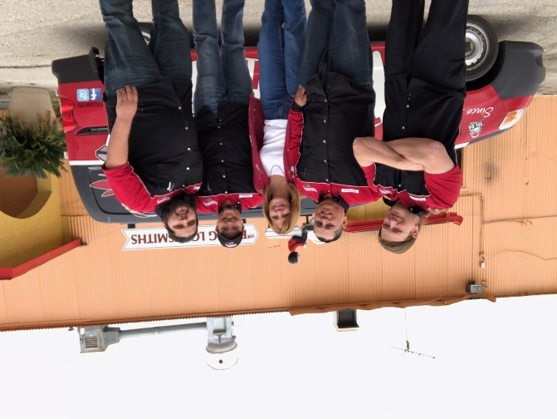
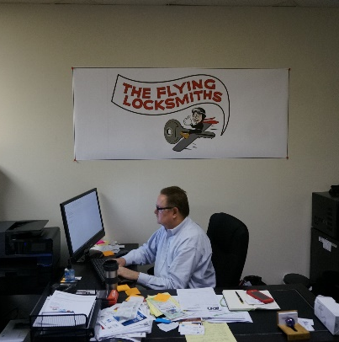
PROVIDING QUALIFIED, TRUSTWORTHY NATIONWIDE
COMMERCIAL & RESIDENTIAL SECURITY SOLUTIONS
Site Criteria
300 - 400 square feet of office space for admin and parts inventory storage.
Trade Area: Urban areas with dense population. Minimum territory size 200k people and 5k businesses.
Training
1 week at Corporate location, 1 week at franchisee location. We cover all of the operational and technical aspects of operating the business.
Financing
SBA Express
FranFund Select
TFL Franchise Systems, LLC ® 2020
100 Grossman Drive Suite 305 Braintree, MA 02184

Slide 20
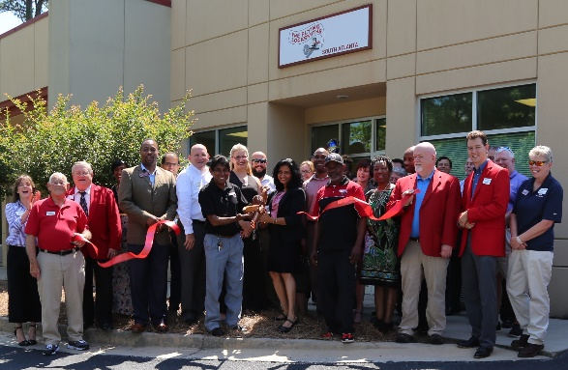
PROVIDING QUALIFIED, TRUSTWORTHY NATIONWIDE
COMMERCIAL & RESIDENTIAL SECURITY SOLUTIONS
FAQs
  q) What size building do I need for the office?
    a) should be between 300 and 400 sq. ft.
  q) How many people will I need to hire?
  a) Most likely you’ll start with 1 technician and 1 sales/marketing person.
  q) Will you help me find the right people?
    a) We will give you profiles for the type of people you need to hire. We have a full section covering staffing in the operations manual. There are job descriptions, roles & responsibilities and even sample employments ads. We even assist with interviews.
  q) What are the standard hours of operation?
  a) Monday - Friday. 8:00am to 5:00pm - After Hours Emergency Service
TFL Franchise Systems, LLC ® 2020
100 Grossman Drive Suite 305 Braintree, MA 02184

Slide 21
PROVIDING QUALIFIED, TRUSTWORTHY NATIONWIDE
COMMERCIAL & RESIDENTIAL SECURITY SOLUTIONS
FAQs
q) What does it take to be a successful franchise partner?
  a) ideally, we are looking for individuals who have experience in the business world and who know what it takes to be successful.
This will include the following:
  Business to business networking.
  an entrepreneurial spirit and strong desire to work hard and achieve results.
  someone who wants to be part of a franchise team.
  ability to manage finances including an understanding of business financial statements.
  a commitment to personally manage and be responsible for the day-to-day operations of the business.
  willingness to train and become proficient in all aspects of operating a successful Flying Locksmiths business.
  an acceptable credit history.
  sufficient assets to invest in and maintain the business
TFL Franchise Systems, LLC ® 2020
100 Grossman Drive Suite 305 Braintree, MA 02184

Slide 22
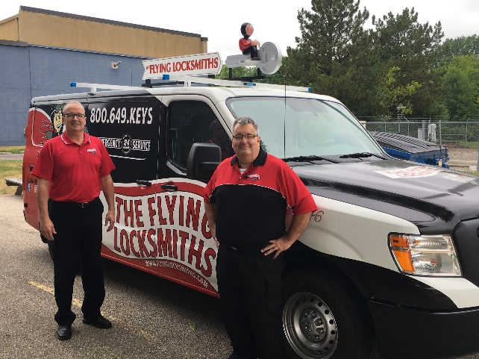
PROVIDING QUALIFIED, TRUSTWORTHY NATIONWIDE
COMMERCIAL & RESIDENTIAL SECURITY SOLUTIONS
FAQs
q) How much of the revenue is service based v. parts?
  a) About 60% of revenue is for service and 40% is for parts.
q) How much of the revenue is repeat business?
  a) About 65% of revenue is from repeat customers.
q) How many jobs will each van do per day?
  a) A typical locksmith will make 6-8 calls a day. Occasionally, we have jobs that will require the tech to be there for a week!
q) Is it hard to retain locksmiths?
  a) We have very little turnover. Dennis has been with us 25 years, Mark has been here for 20, Gary has been 10 years, Chris has been here 5 and Jake started two years ago. We have a good system in place, and try very hard to keep the guys we train.
TFL Franchise Systems, LLC ® 2020
100 Grossman Drive Suite 305 Braintree, MA 02184

Slide 23
PROVIDING QUALIFIED, TRUSTWORTHY NATIONWIDE
COMMERCIAL & RESIDENTIAL SECURITY SOLUTIONS
FAQs
q) Are there referral networks in the locksmith industry?
  a) We made it a priority a long time ago to work closely with third party vendors. These vendors are calling on behalf of almost all of the popular stores and franchises. For example: Bank of America is not having branch managers call locksmiths. They put a call into a third party vendor called Locknet, who calls the appropriate company. By cultivating these third parties, we have developed very strong relationships. We will inform these companies about a new franchise opening and immediately start getting worked dispatched in the new territory. We now work with 80 of these 3rd parties representing several hundred companies.
q) What are some of the other relationships to cultivate?
  a) We work very closely with maintenance and property managers. Those two completely different roles, will call us multiple times in a week. If franchisees targets either of those two people, work will be guaranteed work for as long as they maintain the relationship.

Slide 24
PROVIDING QUALIFIED, TRUSTWORTHY NATIONWIDE
COMMERCIAL & RESIDENTIAL SECURITY SOLUTIONS
FAQs
q) How are locksmiths typically paid?
  a) This will vary from region to region. Our locksmiths are paid hourly. The range is from $12 for a trainee to $30 for an experienced technician. They drive the locksmith vans to and from work, which is a popular benefit for the techs. We monitor them with GPS tracking, so they are not used for personal reasons. We also provide uniforms and cell phones. As far as bonuses, they are based on gross sales per technician. The highest grossing technician will usually receive a bonus of up $2,000 for being the lead tech. We also offer them 50% of the labor portion of any emergency service calls. We have technicians that love doing emergency calls.
q) What is the average revenue per job?
  a) They do vary greatly, but a typical job would be $200 - $300. There will be jobs that take 3 days and are priced out around $30,000 for card access systems and exit devices, closers, etc.
TFL Franchise Systems, LLC ® 2020
100 Grossman Drive Suite 305 Braintree, MA 02184

Slide 25
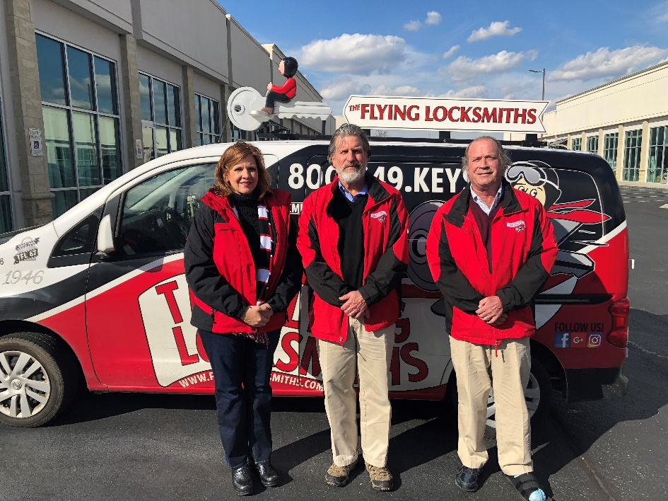
PROVIDING QUALIFIED, TRUSTWORTHY NATIONWIDE
COMMERCIAL & RESIDENTIAL SECURITY SOLUTIONS
FAQs
q) For my Sales/marketing person, what would their compensation look like?
  a) This will vary from region to region and depend on what they are responsible for, but would typically be something like $50K salary with a bonus based on how much additional revenue they produced for the year. Typically 5% -8% of revenue growth.
TFL Franchise Systems, LLC ® 2020
100 Grossman Drive Suite 305 Braintree, MA 02184

Slide 26
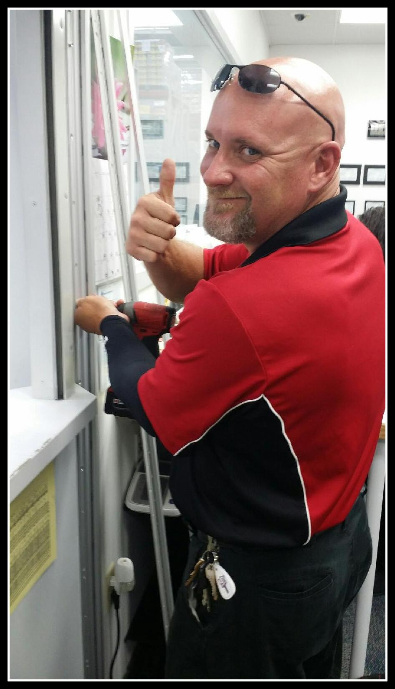
PROVIDING QUALIFIED, TRUSTWORTHY NATIONWIDE
COMMERCIAL & RESIDENTIAL SECURITY SOLUTIONS
Franchise Award Process
  Step one
  Complete on-line application. Conduct introduction overview call.
  Step two
  Receive and review the franchise disclosure document.
  Step three
  Attend validation calls with current franchisees.
  Step four
  Schedule discovery day visit and territory mapping webinar.
  Step five
  Receive franchise approval, begin business launch project.
TFL Franchise Systems, LLC ® 2020
100 Grossman Drive Suite 305 Braintree, MA 02184

